Slide 1
Serverless Patterns
ARCHITECTURE EXCELLENCE INITIATIVE
October 2nd 2019

Slide 2
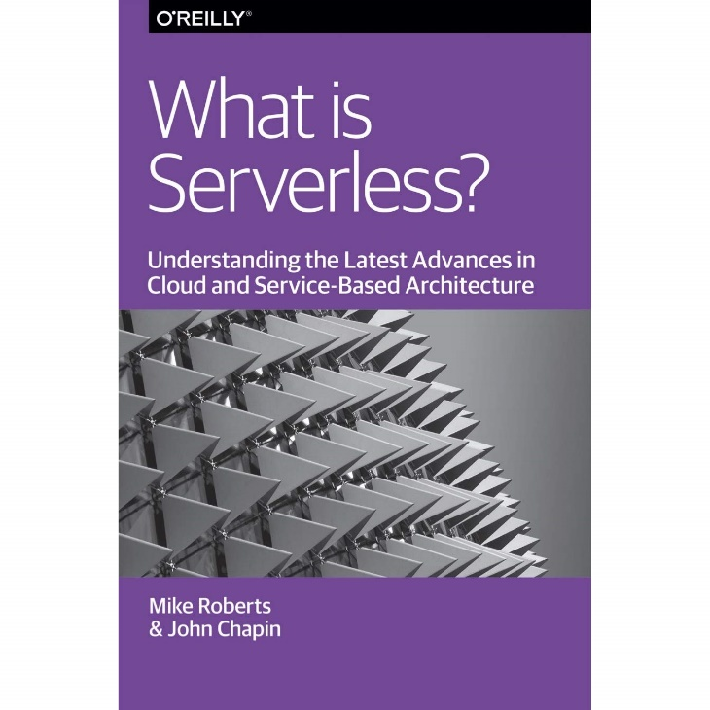
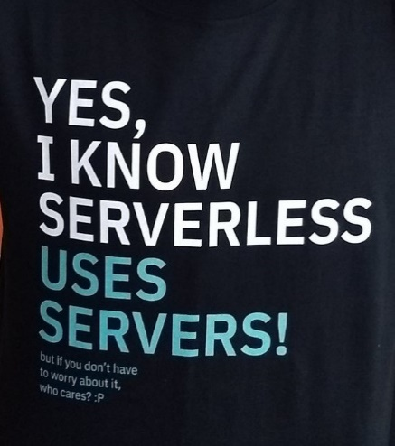
Agenda
1
About presenter
2
Serverless Computing
3
What are Patterns?
4
Serverless Pattern Categories
5
Serverless Patterns
6
Conclusion

Slide 3




Mykhaylo Stepanyak
Solution Architect
10+ years of dev, software architecture, and systems architecture background
2+ years at EPAM
Background:
Pre-EPAM: Full-stack development
Growth at EPAM: D4 -> SA L1
Specialization:
Distributed computed systems
Cloud computing
Engineer<T> where T : C# | AWS | Azure | JavaScript
More… go to
@mstepanyak
Professional

Slide 4
What is serverless computing?

Slide 5

Serverless computing
It is serverless the same way WiFi is wireless
“Serverless is without servers like WiFi is without wires.
With WiFi there are still wires (e.g. router attached to cable modem), but you don’t care about them anymore.“
Gojko Adzic
https://gojko.net/2016/08/27/serverless.html

Slide 6








Serverless Computing
Serverless architecture =
FaaS + BaaS
AWS Lambda
FaaS
BaaS
Amazon
API Gateway
Amazon S3
Amazon
Cognito
Microsoft Azure Function
Firebase
Auth0
Google Cloud Function

Slide 7
Lambda: The execution lifecycle
Download
your code
Start new
container
Bootstrap
the runtime
Start your
code
Cold start
Warm
Start
Time
AWS optimization
Your optimization
https://plot.ly/~nathanmalishev/10/#plot

Slide 8
Lambda Best Practices
Serverless all the things
Minimize package size to necessities
Put your dependency (e.g. jar files) in separate directory
Improve dependency injection with smaller and simpler IoC frameworks that loads quickly on startup, like Dagger2
Leverage smaller and faster frameworks
Use Environment Variables to modify operational behavior
Secure secrets/tokens/passwords with Parameter Store and AWS Secret Manager

Slide 9
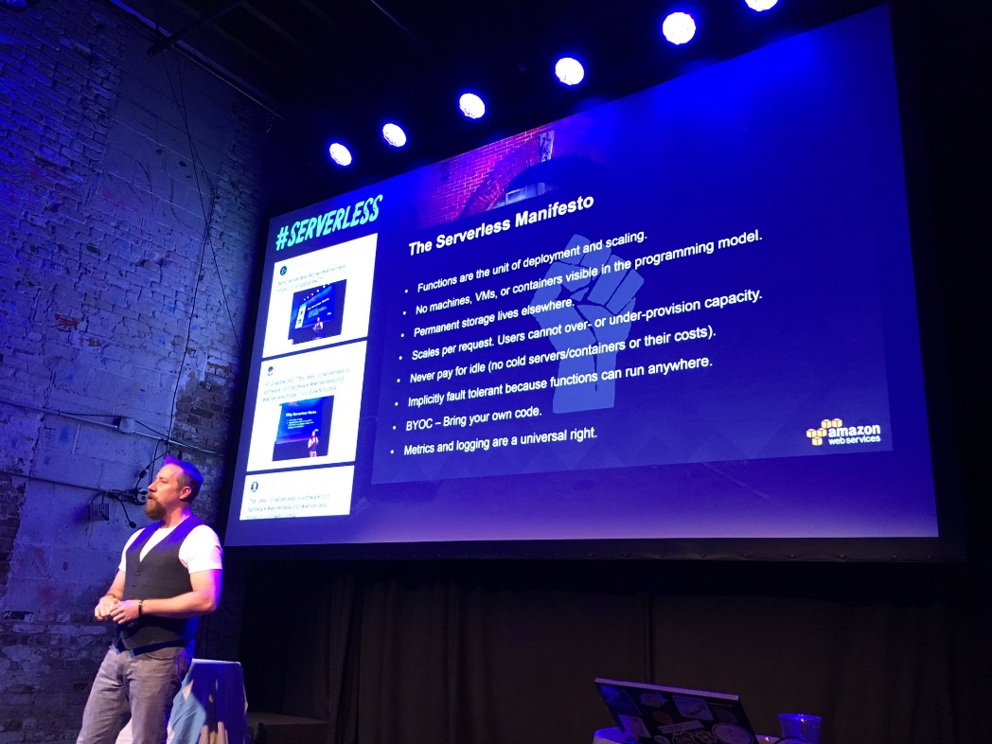
Serverless. Let’s make it clear!
The Serverless Compute Manifesto
Function are the unit of deployment and scaling.
No machines, VMs, or containers visible in the programming model.
Permanent storage lives elsewhere (SLE).
Scales per request; Users cannot over- or under-provision capacity.
Never pay for idle (no cold servers/containers or their costs).
Implicitly fault-tolerant because functions can run anywhere.
Bring Your Own Code (BYOC).
Metrics and logging are a universal right.

Slide 10
Main challenges of serverless computing
Costs of serverless services
Cold start
Resource limits
Inadequate application testing
Increased security concerns
Vendor compatibility
Monitoring and debugging
Function state
Execution time limitations
Availability of skills
Composability - Access to the file system level
Multi-tenancy concerns

Slide 11
What are Patterns?

Slide 12

What are Patterns?
Why patterns interest me
“Patterns … identify common solutions to recurring problems.“
Martin Fowler
https://www.martinfowler.com/ieeeSoftware/patterns.pdf

Slide 13
Serverless Pattern Categories
Notes:
As Serverless really impact the entire software development lifecycle. Before we go to the patterns, I would like to talk about categories
So, what I mean by that?

Slide 14
Serverless pattern categories
Solution Choice
Application Patterns
Feature Patterns

Slide 15
Serverless pattern categories
Solution Choice
Design
Application Patterns
Architecture Patterns
Feature Patterns
Service and Function Patterns

Slide 16
Serverless pattern categories
Solution Choice
Design
Develop
Application Patterns
Architecture Patterns
Development Patterns
Feature Patterns
Service and Function Patterns

Slide 17
Serverless pattern categories
Solution Choice
Design
Develop
Operate
Application Patterns
Architecture Patterns
Development Patterns
Deployment Patterns
Feature Patterns
Service and Function Patterns
Monitoring Patterns

Slide 18
Application Patterns

Slide 19
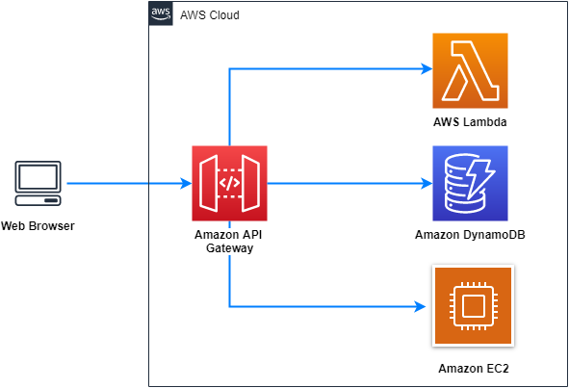
Serverless API Pattern
How do I build an HTTPS API without having to consider resource management or scaling concerns?

Slide 20
Serverless API Pattern - Decouple reply from initial request
Client
API
Worker
POST/do_action
do_work
202/result_location
GET/result_location
202/result_location
work done
GET/result_location
200 OK

Slide 21
Serverless API Pattern
How do I build an HTTPS API without having to consider resource management or scaling concerns?

Slide 22
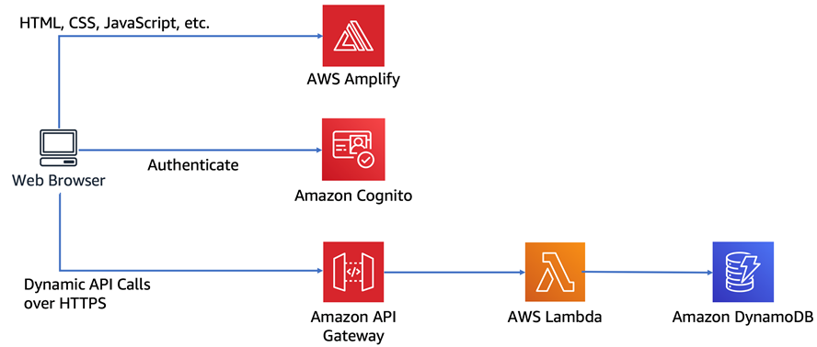
Serverless API Pattern

Slide 23
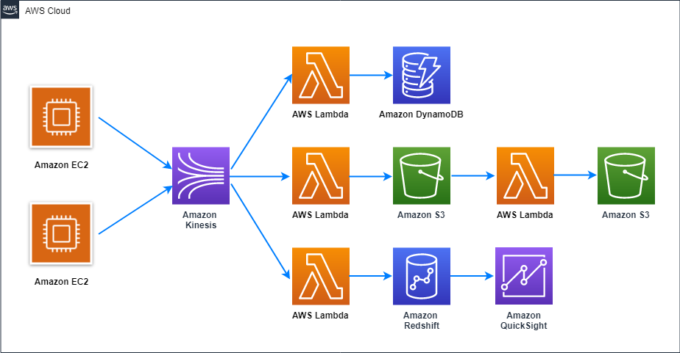
Serverless Data Pipeline
How do I build a data pipeline that has great scaling capabilities, and also allows new components to be added without significant infrastructure knowledge?

Slide 24
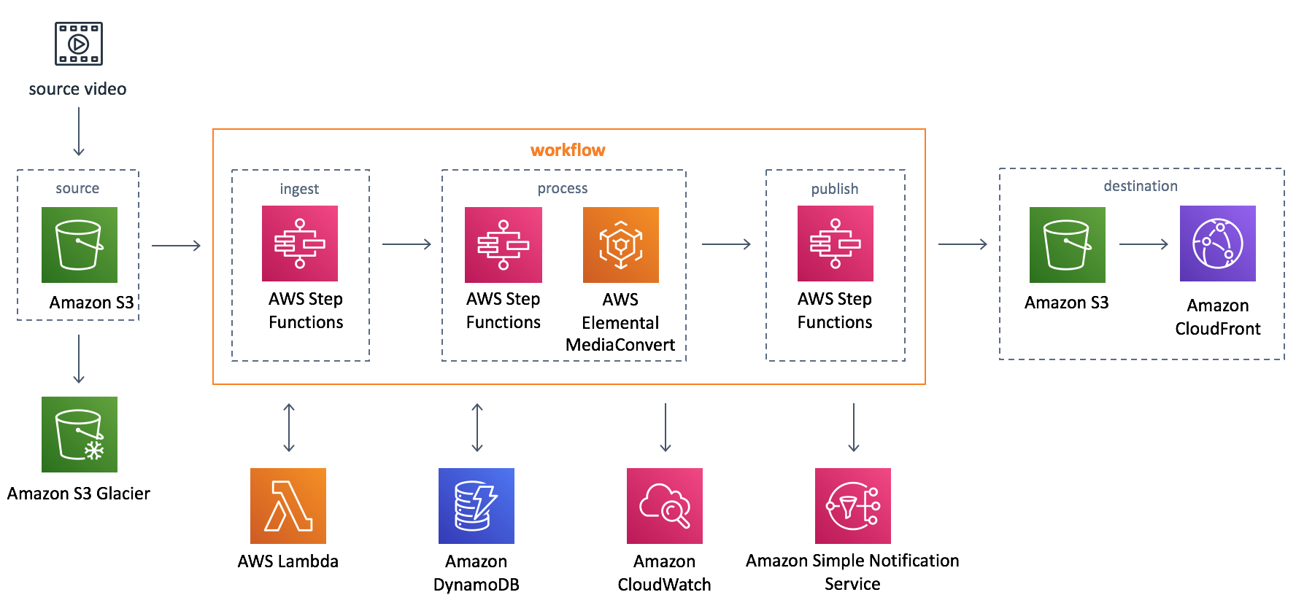
AWS Step Functions or State machine as a Service

Slide 25




AWS Step Functions or State machine as a Service
workflow
Begin transaction
AWS Step
Functions
lambda-book-hotel
Start book hotel request
End book hotel request
lambda-book-flight
actions
lambda-book-car-rental
Start book flight request
End book flight request
lambda-cancel-hotel
lambda-cancel-flight
compensating
actions
Start book car rental request
End book car rental request
lambda-cancel-car-rental
End transaction

Slide 26
AWS Step Functions or State machine as a Service
Start
AWS Step
Functions
BookHotel
BookHotel
BookFlight
BookFlight
BookCarRental
CancelCarRental
End
CancelFlight
CancelFlight
CancelHotel
CancelHotel
Fail
Fail

Slide 27
Feature Patterns

Slide 28
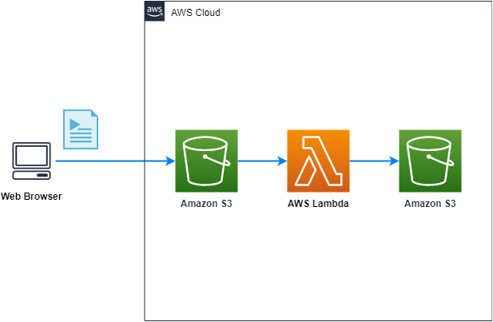

Feature Patterns - Ephemeral Media Transformer
How do I have a highly scalable capability of processing media files without having to constantly run servers?
AWS Elemental
Media Convert

Slide 29
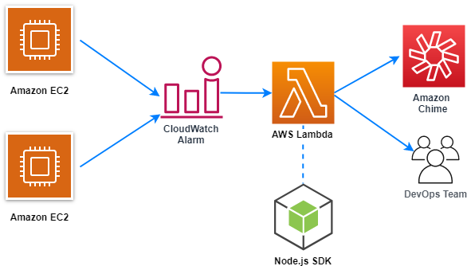
Feature Patterns - Cronless Cron Job
How do I run occasional tasks, on a schedule, having an individual environment for each task, in a cost efficient way?

Slide 30
Architecture Patterns

Slide 31
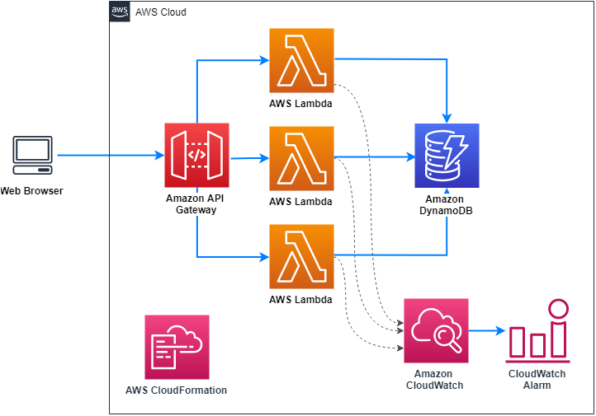
Serverless Application
How do I group number of different functions and configured services within one coherent, deployable, unit.

Slide 32
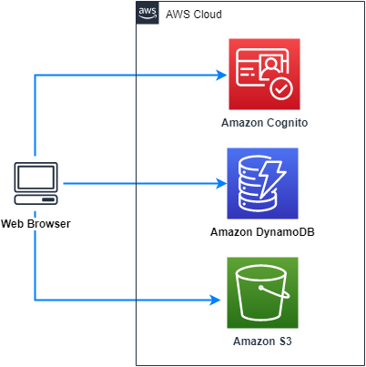
Client-Service
How do I build an application where BaaS services satisfy all of my server-side needs?

Slide 33
Service & Function Patterns

Slide 34
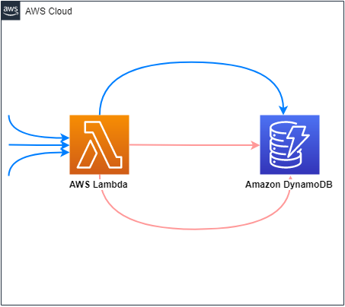
Idempotent Function
How do I guarantee that there is at most one side-effect for each event that triggers a FaaS function?

Slide 35
Development Patterns

Slide 36
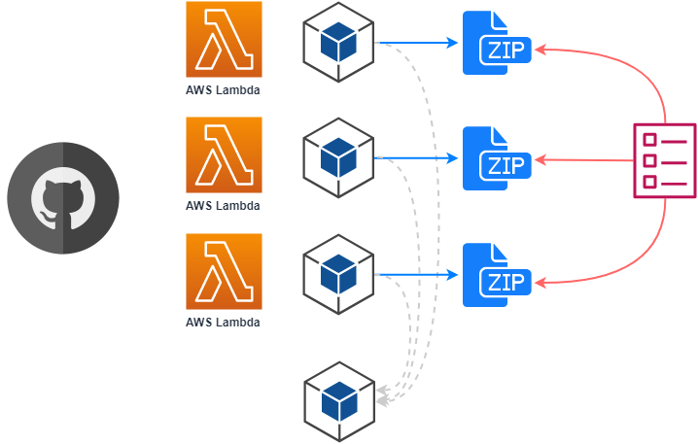

Serverless Application MiniMono
How do I setup a source tree for a collection of FaaS Functions in a way that shares code, but doesn’t overly inflate each Function’s distribution artifact?
AWS Serverless
Application Repository

Slide 37
deployment Patterns

Slide 38
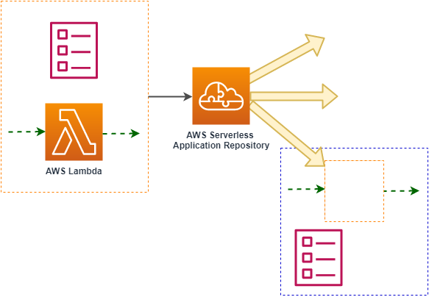
Published Component
How do I create a component, with its own infrastructure definition, that solves a recurring problem, and share it within multiple applications?

Slide 39
Monitoring Patterns

Slide 40
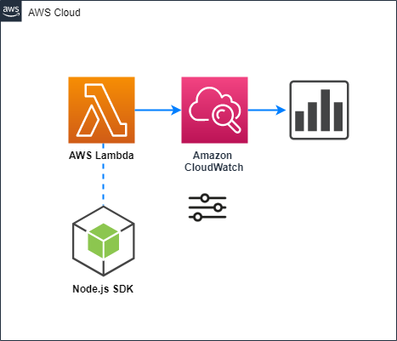
Log Sourced Metric
Capture application metrics when a metric collection service may not be able to handle the scaling behavior of functions deployed to a FaaS platform?

Slide 41
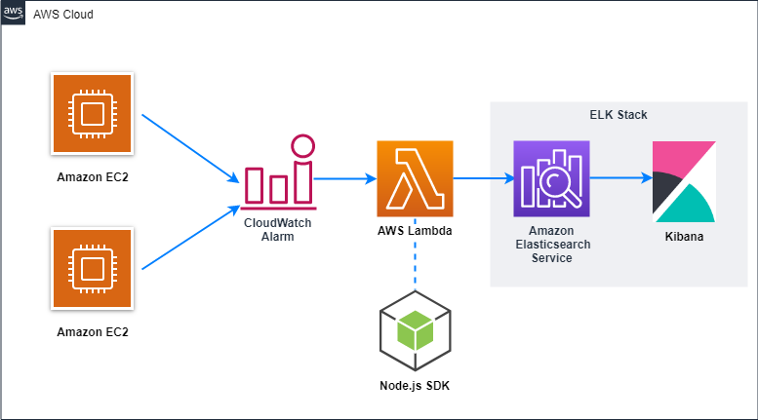
Log Sourced Metric
Monitor host-based intrusion detection system alerts on Amazon EC2 instances

Slide 42



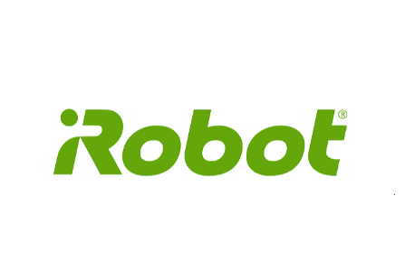



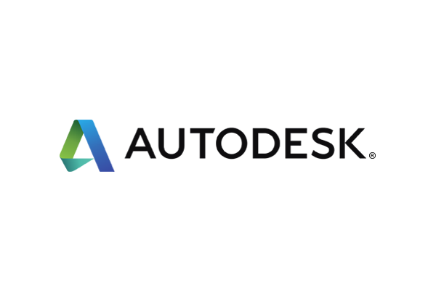

Customer case studies
https://aws.amazon.com/lambda/resources/customer-case-studies/

Slide 43
Conclusion
Serverless will continue to explode
Developers will continue to move important workloads to managed services (Auth0, Algolia, AppSync, Firebase, etc)
Nowadays, developers need to know devops in order to build enterprise applications
Cross-platform flourishes

Slide 44
Thank you!

Slide 45
Serverless Patterns
ARCHITECTURE EXCELLENCE INITIATIVE
October 2nd 2019
CONFIDENTIAL | © 2019 EPAM Systems, Inc.

